Slide 1
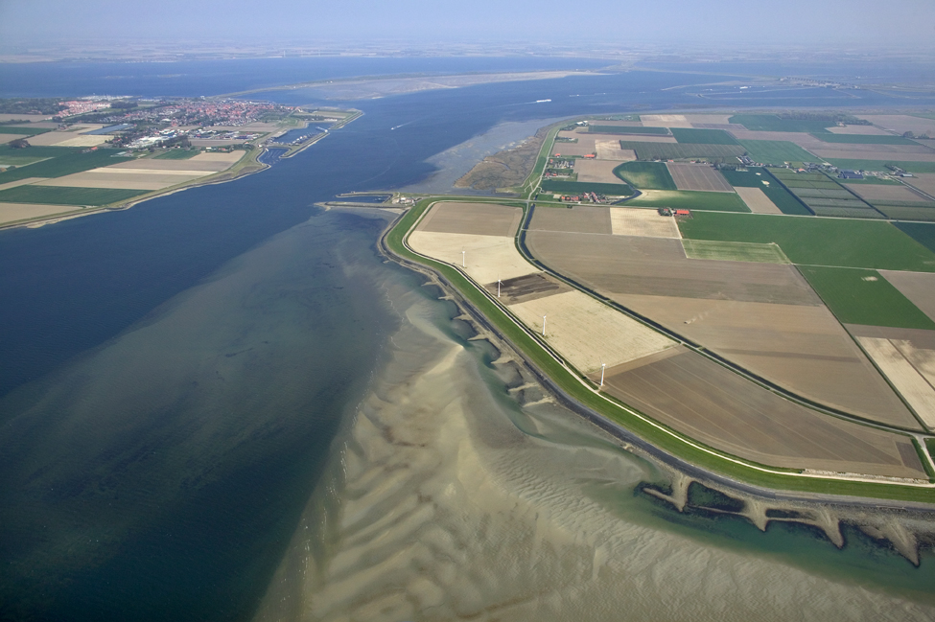


Importing data

Slide 2
Importing data
Data import
Import meteorological forecasts and water
level and discharge measurements
Pre-processing (transformations)
Pre-adapter
Run model
Post-adapter
Post-processing
Visualisation

Slide 3
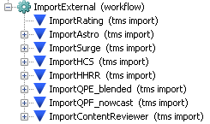
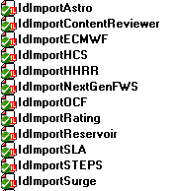
Data import configuration
Import configuration is defined in:
%REGION_HOME%\*_global.properties
Defines global token with the import directory root
\ModuleConfigFiles\Import\Import<TYPE>*.xml
Import instructions for TYPE
\IdMapFiles\IdImport<TYPE>.xml
Provides id mapping instructions voor TYPE
Idmap typically fixed or derived from location attributes
\MapLayerFiles\sensors.csv
\RegionConfigFiles\LocatioSets.xml
\RegionConfigFiles\ValidationRuleSets.xml
Defines primary validation rules
\RegionConfigFiles\ModuleInstanceDescriptors.xml
Registers import module instance
\WorkflowFiles\ImportExternal.xml
Lists all import module instances to run as part of import workflow
See http://publicwiki.deltares.nl/display/FEWSDOC/03+Import+Module

Slide 4
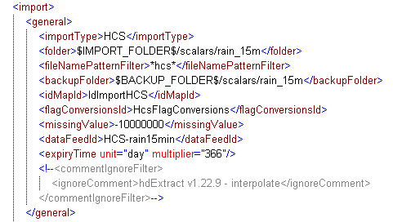
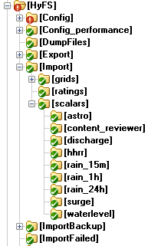
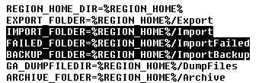
Let’s have a look at such import module instance
Module instances for different import file formats
Directories organized in folders, e.g. by data type (parameter)
Each module can import data from one or more directories
Global properties:

Slide 5
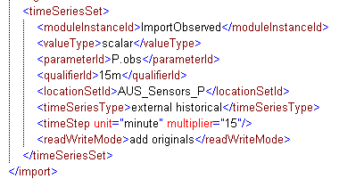
Let’s have a look at such import module instance
TimeSeriesSet specifies storage instructions
Who generated (ModuleInstanceDescriptors.xml)
Internal data storage format
What does it represent (Parameters.xml, Qualifiers.xml)
Where does it apply (LocationSets.xml)
What behaviour
What time step do values apply

Slide 6
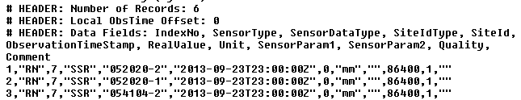

Let’s have a look at such import module instance
IdMap defines translation table between external and internal identifiers
IdMap derived from meta data
RN→ P.obs
052020-2→ H052020-02

Slide 7
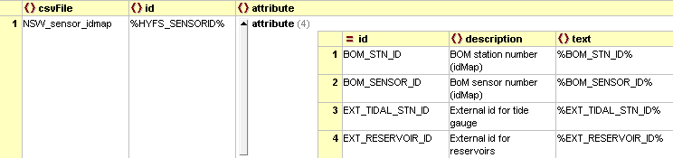
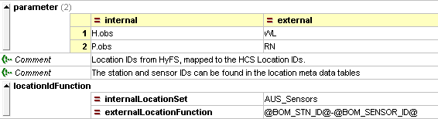
IdMapping (translation) with location attributes
Attribute definition example from: LocationsSets_NSW.xml
Define identifier attributes
Define attribute values per location
Apply during import/export to translate identifiers Replaces ‘@attribute-name@’ with attribute value
Attribute values example from: NSW_sensor_idmap.csv
Attribute usage example from: IdImportHCS.xml
Internal to FEWS
Delft-FEWS Configuration Course
September 2013
7
Notes:
7

Slide 8
OpenDAP
Delft-FEWS can import data directly from OpenDAP databases. OpenDAP is a database type commonly used in the world of coastal and oceanographic forecasting.
See http://publicwiki.deltares.nl/display/FEWSDOC/Import+data+using+OPeNDAP

Slide 9
Visualization
Once available in Delft-FEWS, data can be visualized in various ways:
- Gridded data can be shown in de grid display
- Scalar data can be shown in the filters, predefined plots and grid display
- The layout of plots can be modified in various ways
See http://publicwiki.deltares.nl/display/FEWSDOC/07+Display+Configuration

